Slide 1
Introduction to Software Business Product management
Week 4 Day 2
Led by: Emily Crose
for
Oakland University

Slide 2
Review of day 1

Slide 3
Questions From Day 1?

Slide 4
Terms to listen for
Binaries
Executable files

Slide 5
Practicing With Git
https://learngitbranching.js.org/
Alternatives
https://gitimmersion.com/lab_01.html

Slide 6

Branching With Teams

Slide 7
Pull

Slide 8
Working With Others

Slide 9

Forking

Slide 10
Editing a forked repository
Notes:
Practical slide – show what happens when a repository is forked

Slide 11
Pull Request

Slide 12
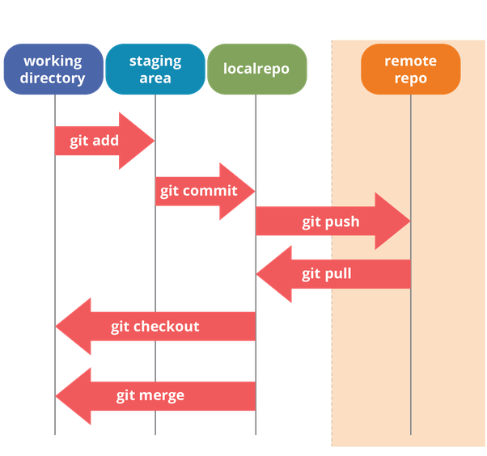
Workflow revisited
Notes:
If we go back to our workflow slide, let’s remember what we need to do before we put in our pull request

Slide 13
Code review
Allows changes to be approved
Limits bad code merges
Adds a layer of safety
Notes:
Before we approve a pull request, we need to validate that the code is in good shape. To do this, we will review the code, and approve it. My team calls this “stamping” changes. Within git, you can change how many reviewers are needed before you can merge the changes.

Slide 14
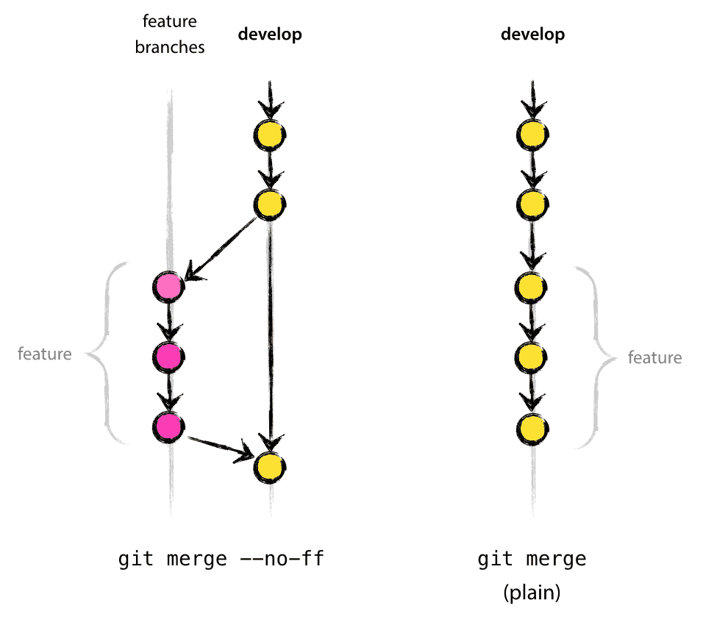
Merging Changes

Slide 15
Release Candidates

Slide 16
Building binaries

Slide 17

Release Notes

Slide 18

Licensing
Software can be copyrighted
How do we protect our “Intellectual Property”?

Slide 19

Broad categories of software licensing
Weak Copyleft
Copyleft
Commercial or Proprietary
Dual
Public Domain

Slide 20
Permissive
Permissive
Minimally restrictive on modifications or redistribution
Typically, only require acknowledgements

Slide 21


Weak Copyleft
Allows linking to open source libraries
Minimal requirements
Modifying the library is more complicated than permissive
Examples:
Gnu Lesser General Public License (GLPL)
Mozilla Public License (MPL)
CDDL
Eclipse

Slide 22

Copyleft
A.K.A. “Reciprocal” licenses or “Restrictive” licenses
Not as commercially friendly
Requires publication of source code for derivative works
Not good for commercial products!
Examples:
Gnu Public License (GPL)

Slide 23
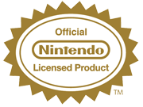

Commercial/Proprietary
Most restrictive
Typically used by corporations
Typically closed source

Slide 24

Dual
May differ for different types of users
Examples:
Server-Side Public License (SSPL)

Slide 25

Public Domain
Copyright protections do not apply
Hard to find software in this category
Most permissive

Slide 26
Unlicensed
Can be complicated
Notes:
For companies to use this, they will need to request a license to be applied to the software work. It can be complicated to use unlicensed works if there’s no explicit license attached to it.

Slide 27
Licensing concerns
Notes:
You need to concern yourself with licensing types, and how they might impact you. For example, you may be building software using a library that relies on a license that does not allow for commercial use.

Slide 28
Architecture Design

Slide 29
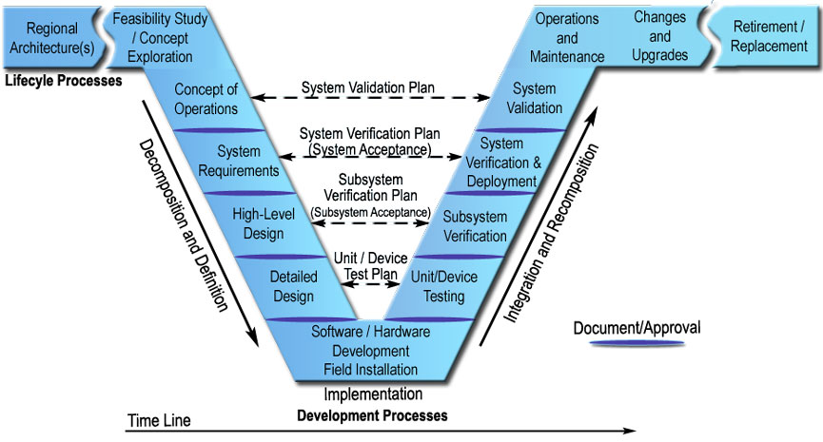
V-Model of Systems engineering

Slide 30
Notes:
We need to talk about the V-model of engineering, which is a document we would have generated during our planning phase. The V-Model will span a space within our build cycle from planning to deployment, so let’s take a close look at this and see how this applies to our build effort. In past classes, we talked a bit about what a V-model might look like in terms of documentation, but we didn’t talk about how the documentation fits into a larger model of engineering design.

Slide 31
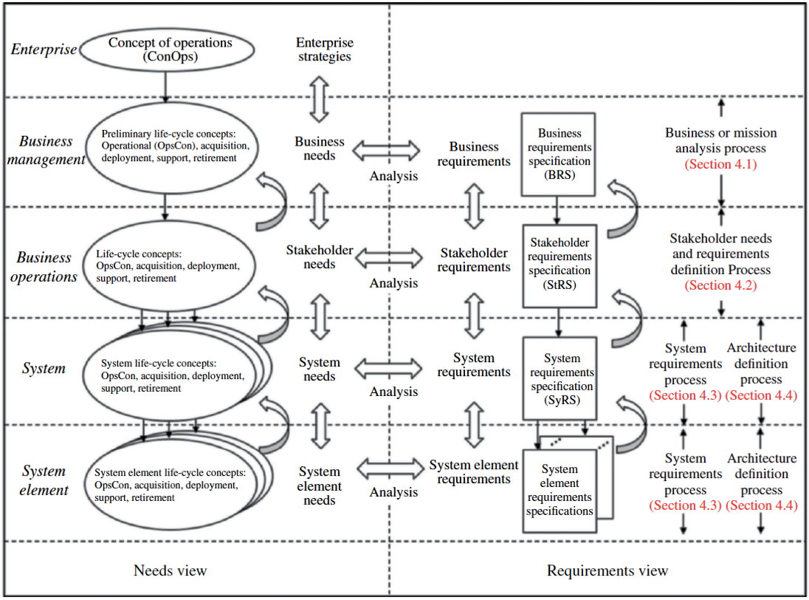
Concept of Operations (CONOP)
Notes:
In past classes, we talked a little about what a Conop is, but let’s see what a CONOP might look like. Here we can see what an example CONOP would look like. The CONOP is a hi

Slide 32
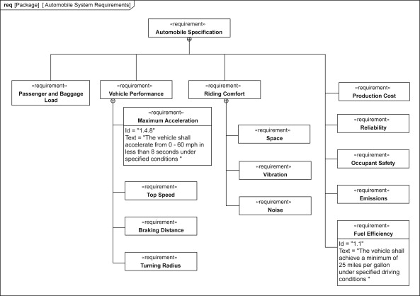
System Requirements Diagram

Slide 33
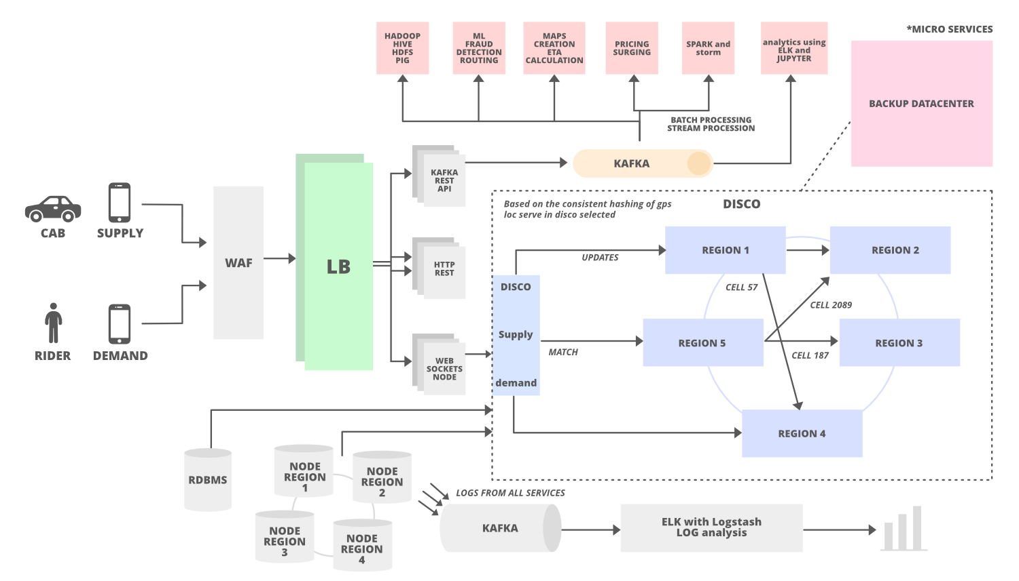
High level design documentation

Slide 34
Testing

Slide 35
Automated Testing
What does our testing pipeline look like?

Slide 36
Manual testing

Slide 37

Review Day 2

Slide 38
Question or clarifications?

Slide 39

Preview day 2

Slide 40
See you next time!

